Slide 1

My Makeup Inventory
Log in
Home
About
Contact

Slide 2

New? Register
Username
Password
Submit
Forgotten password?

Slide 3
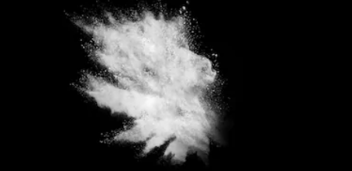
Email Address
Request Password Reset

Slide 4
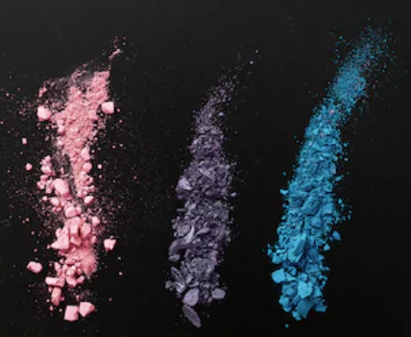
Username
Email Address
Password
Confirm Password
Register

Slide 5

Your Inventory
Add Item
Wish List
Shopping List

Slide 6

By Type
By Brand
By Color
By Rating
Remove | Category | Brand | Color | Paid | Date Bought | Date Expire | Rating (1-5)
inventory

Slide 7

Product Category
Add Item
To Inventory
Product Name
Product Brand
Add Item
To Wishlist
Product Color
Product Category
Add Item
To Shopping
Product Paid
Product Rating

Slide 8

By Type
By Brand
By Color
By Rating
Remove | Category | Brand | Color | Paid | Date Bought | Date Expire | Rating (1-5)
Wishlist

Slide 9

By Type
By Brand
By Color
By Rating
Remove | Category | Brand | Color | Paid | Date Bought | Date Expire | Rating (1-5)
Shopping list

